Slide 1
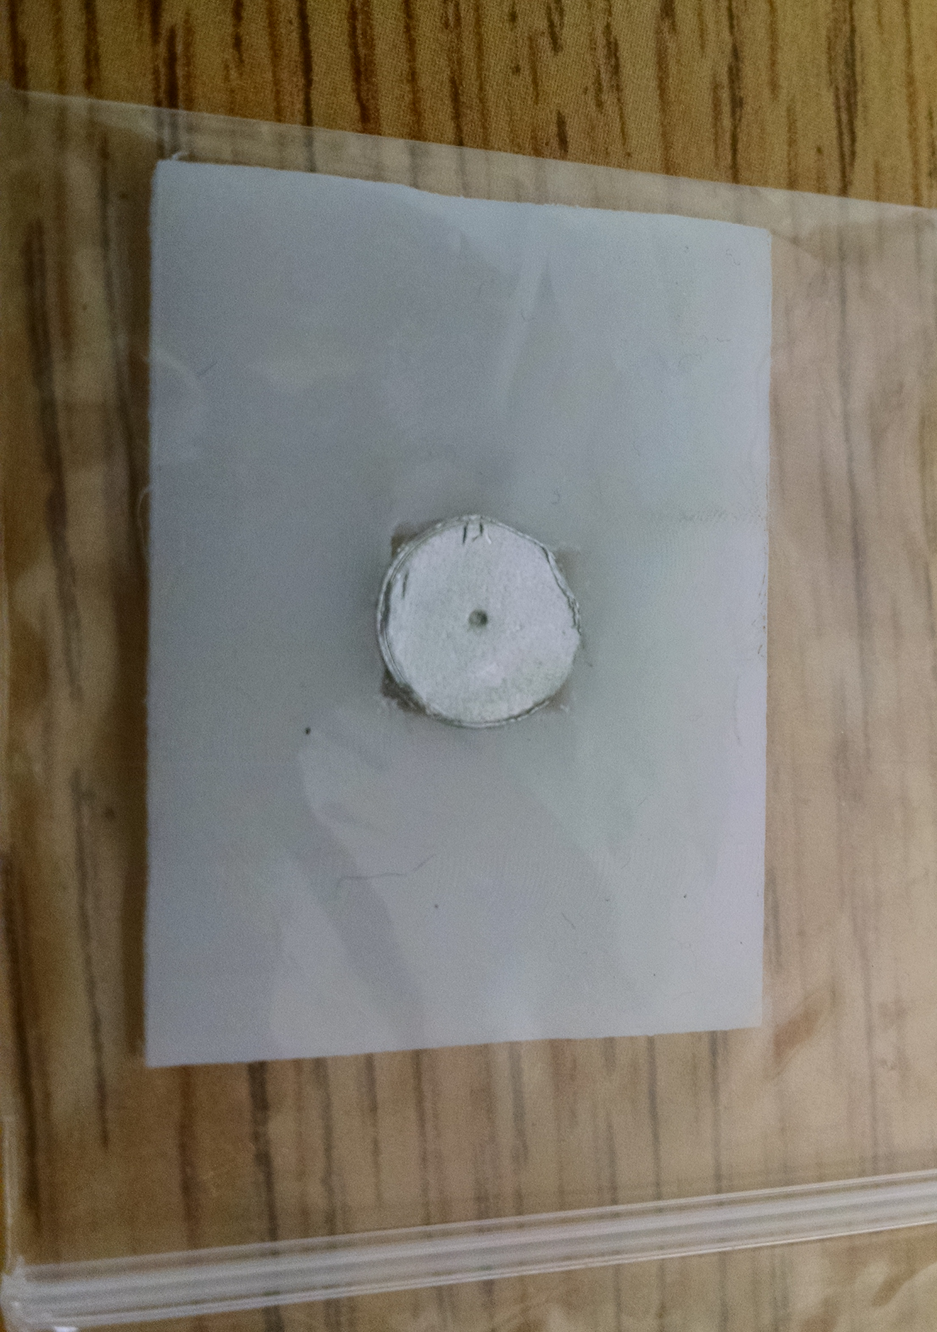
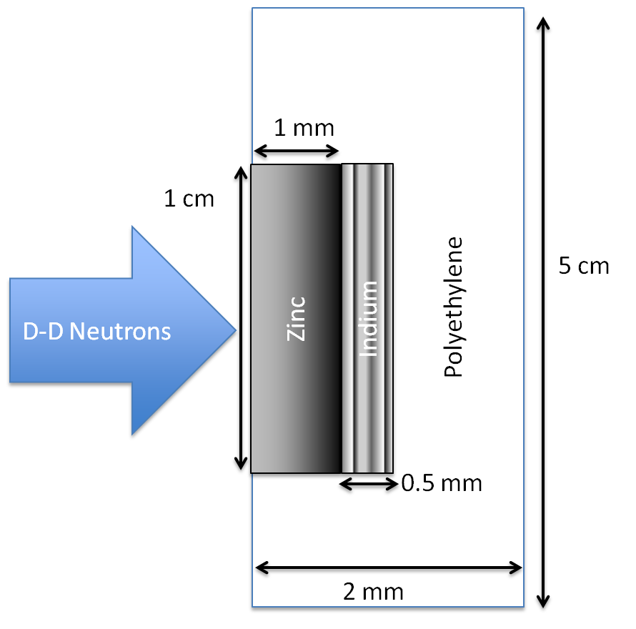
The UC Berkeley High Flux Neutron Generator
Foils Used | Metal Purity | Abundance (a/o) | Foil Density (mg/cm²)
^{nat}In | > 99.999% | ¹¹³In (4.29%), ¹¹⁵In (95.71%) | 365.5
^{nat}Zn | > 99.99% | ⁶⁴Zn (49.17%) | 714.1
^{nat}Ti | 99.999% | ⁴⁷Ti (7.44%) | 450.6
Notes:
64Zn - 49.17%, 66Zn – 27.73%, 67Zn – 4.04%, 68Zn – 18.45%
46Ti – 8.25%, 47Ti – 7.44%, 48Ti – 73.72%, 49Ti – 5.41%, 50Ti – 5.18%

Slide 2
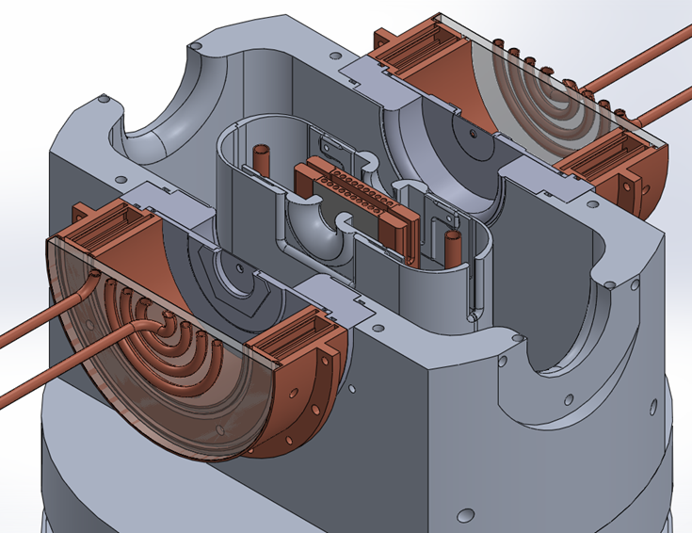
The UC Berkeley High Flux Neutron Generator
Zn
Zn
In
In

Slide 3
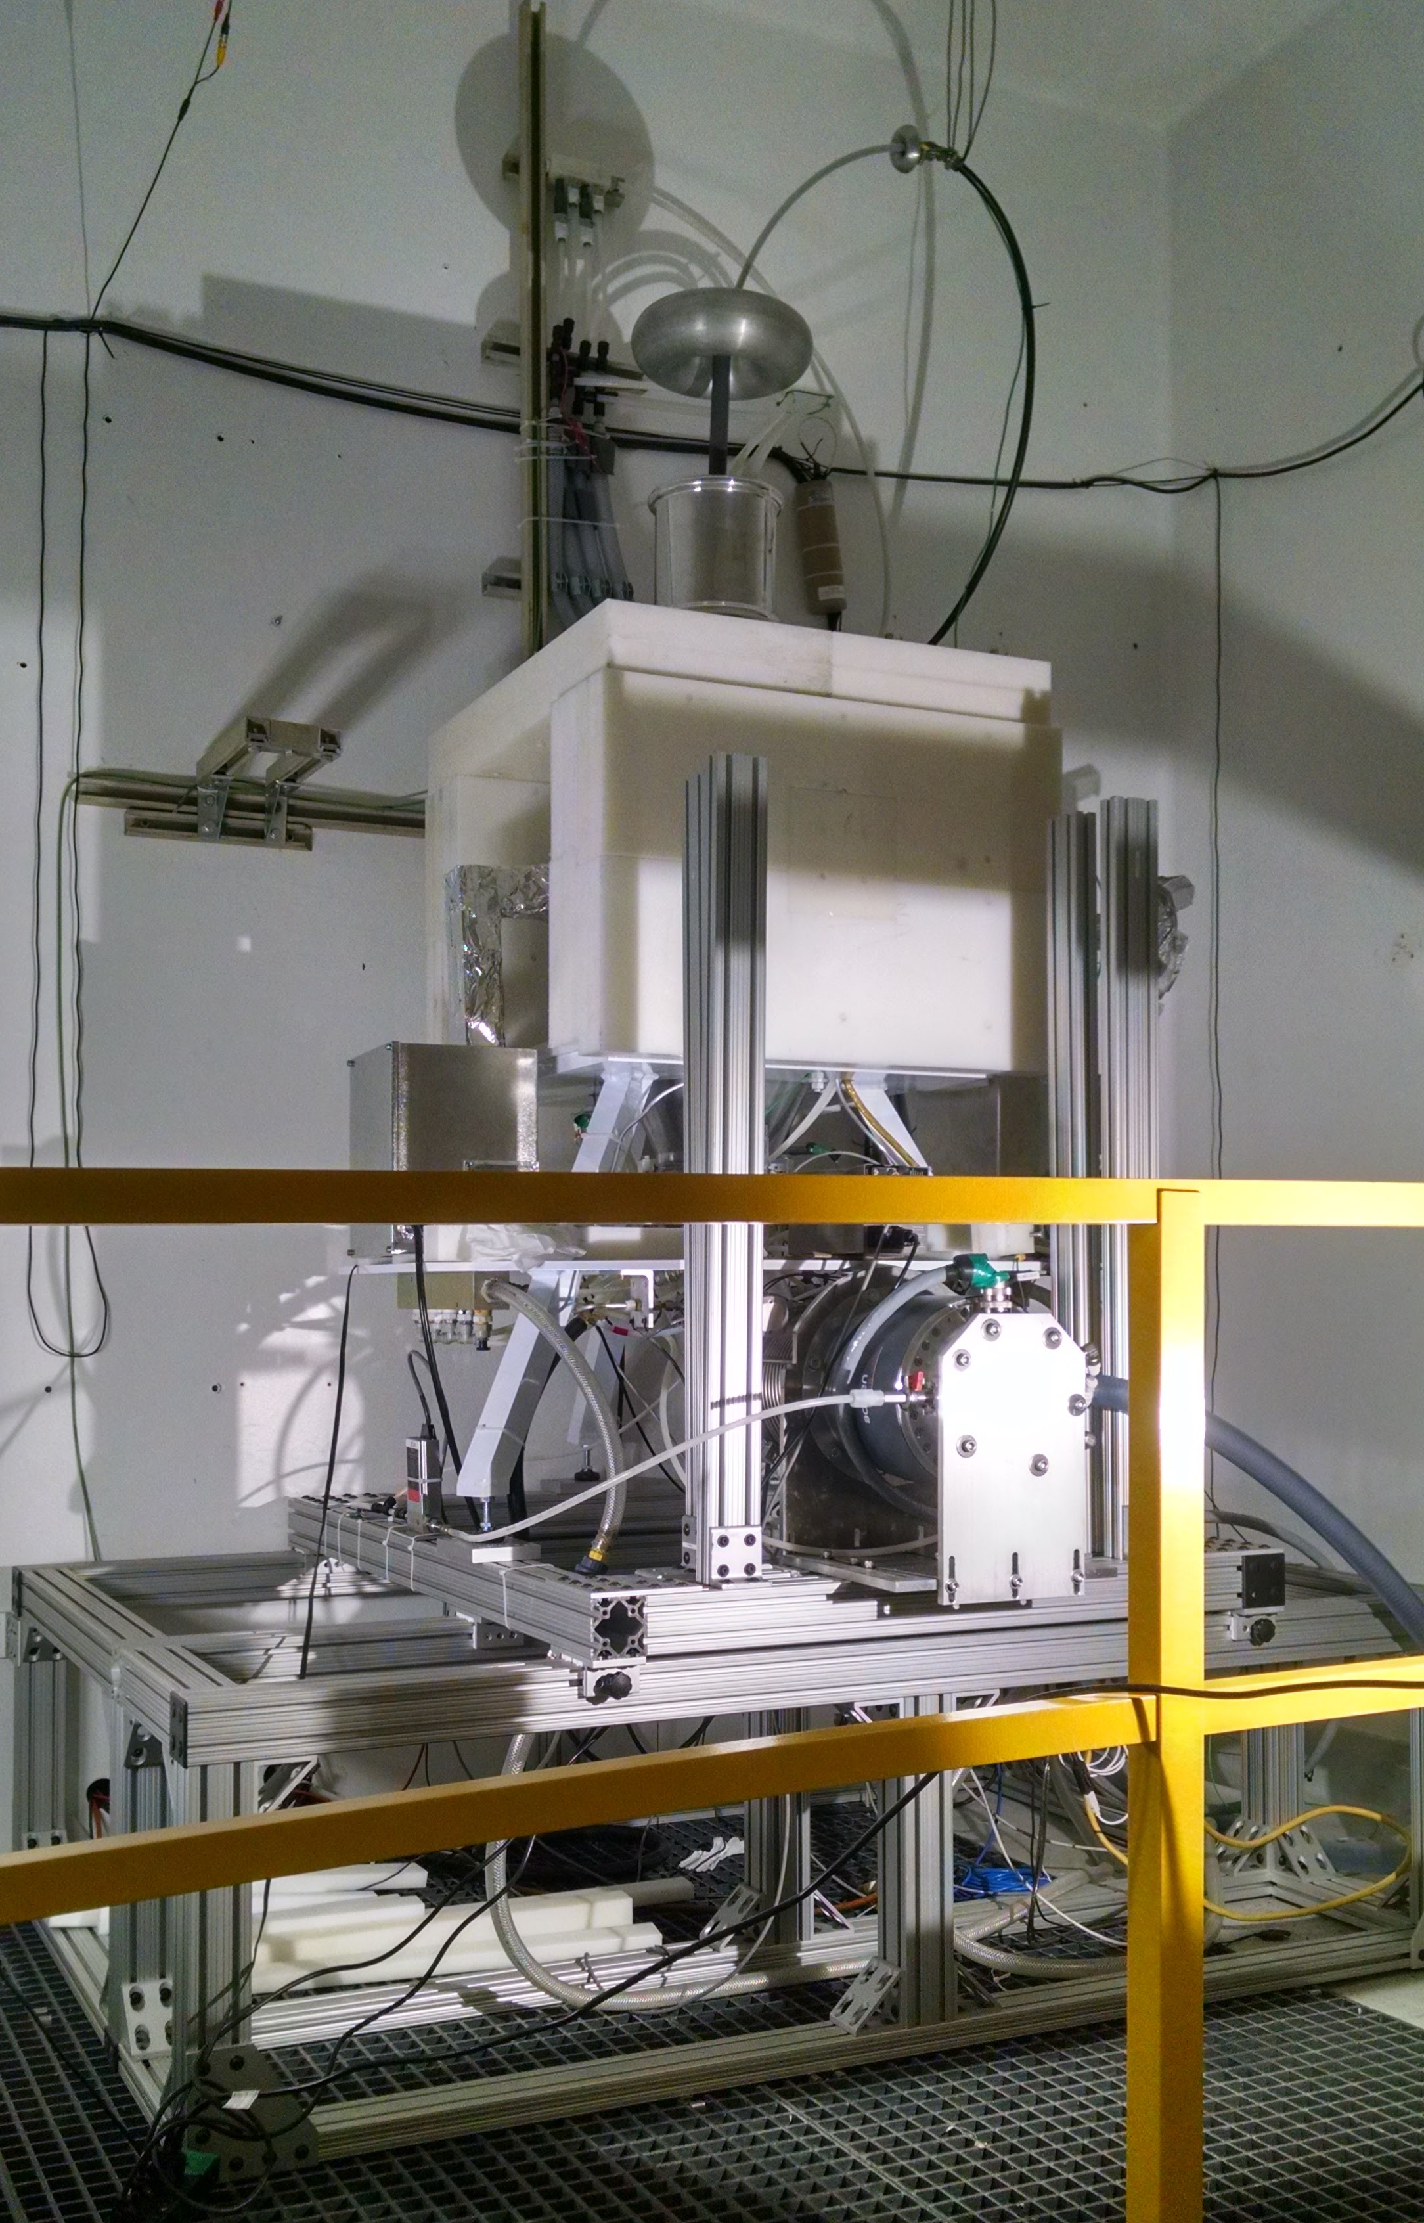
The UC Berkeley High Flux Neutron Generator
Zn
In

Slide 4
Preliminary Cross Section Results

Slide 5
Preliminary Cross Section Results

